Slide 1


Slide 2
Internal Controls
Who is Watching?
Jim Royse, Executive Director
February 19, 2025

Slide 3


Agenda
Internal Controls
Internal Control Checkup
Top 10 Internal Controls
2025 AUP Volunteers

Slide 4
Internal Controls
Good internal controls are good business
Organizations manage risk by balancing risks and controls
Everyone in the organization has responsibility for internal control
Good Internal Controls start with an organizational structure and philosophy which nurtures and rewards integrity, ethical behavior and competence

Slide 5
Why are internal controls important?
Internal controls reduce the likelihood of fraud or errors and provide for:
  Accountability
  Efficient and effective operations
  Reliable management reporting
  Compliance with laws and regulations
  Protection of assets including organizational reputation

Slide 6


Slide 7
Takeaways From Video
Proper Tone at the Top
Controls are Absent – “Free Money”
Good Controls in Place – The eyes are watching
Notes:
Man in Booth – Are you setting the proper tone at top or are you “giving out free money” like the man in the booth
No controls the money is free for the taking
When you have proper controls in place and the eyes are watching then less likely for employees to commit fraud

Slide 8
Tone At The Top
“Effective leaders strive to surround themselves with competent people, instill an enterprise-wide attitude of integrity and control consciousness, and set a positive 'tone at the top”
(Dennis Dycus, CFE, CPA, CGFM, Association of Certified Fraud Examiners)

Slide 9
Tone At The Top
It all Starts With You as the Official
Officials set the moral and ethical compass for all others to follow
Officials must communicate a zero tolerance for fraud and reinforce the message daily – Both in Words and Actions

Slide 10
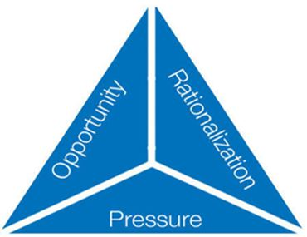
Controls are Absent
  Creates Opportunity
  Fraud Triangle:
    Three Conditions Generally Present When Fraud Occurs:
    Rationalization/Attitude
    Pressure (Need)
    Opportunity

Slide 11
Rationalization/Attitude –
An attitude, character, or set of ethical values that allow an individual to justify committing a dishonest act.
  “I work harder than anyone here, I deserve this.”
  “She makes more than me and I work just as hard or harder and I deserve this”
  “What is going on is my life is unfair, this little extra will help me out and they will never miss it.”
  “I see them doing it, so I will too.”

Slide 12
Incentive/Pressure
Management or other employees may have incentive or be under pressure to commit fraud
  Loss of Family Members Employment
  Divorce
  Personal Financial Problems/Bankruptcy
  Medical Condition
  Drug/Substance Abuse
  Gambling Addiction
  Living Beyond Their Means

Slide 13
Opportunity
Circumstances provide an opportunity for fraud to be committed

Slide 14
Opportunity/Factors Contributing to Fraud
Lack of Internal Controls
Lack of Employees Fraud Education
Lack of Reporting Mechanism
Lack of Segregation of Duties
Blind Trust
Cash not Deposited Daily
  2010 Report to the Nations on Occupational Fraud and Abuse , published by the Association of Certified Fraud Examiners

Slide 15
Impacts of Fraud
Government Outcomes Impact
Reputational Impact
Financial Impact
Business Impact
Notes:
Fraud undermines the government’s ability to deliver services and achieve intended outcomes. Money and services are diverted away from those who need it and the services delivered can be substandard or unsafe. This can lead to program failure.
Fraud can affect any entity. However, when it is handled poorly, fraud can result in an erosion of trust in government and industries, and lead to a loss of economic reputation. This is particularly true when fraud is facilitated by corruption.
Studies have shown Government entities generally lose between 0.5% and 5% of their spending to fraud and related loss based on international estimates.
Costs for dealing with fraud against government programs are significant and go well beyond the direct financial loss. They can include assessment, detection, investigation and response costs as well as potential restitution. In addition, further costs can include program reviews and audits, and retrofitting or redesigning programs.

Slide 16
What can you do?
You can only Control the Opportunity
By implementing a strong internal control system, officials remove the opportunity!

Slide 17
Internal Control Checkup
Establish a Control Environment
Conduct Risk Assessment
Implement Control Activities
Implement Information and Communication System
Monitor Internal Controls
Notes:
These are the 5 components of Internal Controls
The control environment is the culture, values, and expectations that organizations put into place
Management must be aware of and deal with the risks the organization faces. It must set objectives, integrated with other activities so that the organization is operating in concert. Management must also establish mechanisms to identify, analyze and manage the related risks. What can go wrong and what assets do we need to protect?
Control activities are the policies and procedures put into place to run operations, accomplish goals, and prevent fraud
Communications are essential for every organization. They rely on quality of information and effectiveness of dissemination. To be useful, information must be reliable and it must be communicated to those who need it. For example, supervisors must communicate duties and responsibilities to the employees that report to them and employees must be able to alert management to potential problems
Establishing controls is not enough. Once they are in place, you need to verify the effectiveness of the controls. After implementing internal controls, organizations must monitor their effectiveness periodically to ensure that controls continue to be adequate and continue to function properly. Management must also revisit previously identified problems to ensure that they are corrected. Next let’s look at the 17 principles of Internal Controls per GAO.

Slide 18
Control Environment
The oversight body and management should demonstrate a commitment to integrity and ethical values.
The oversight body should oversee the entity’s internal control system.
Management should establish an organizational structure, assign responsibility and delegate authority to achieve the entity’s objectives.
Management should demonstrate a commitment to recruit, develop and retain competent individuals.
Management should evaluate performance and hold individuals accountable for their internal control responsibilities.
SOI: GAO
Notes:
The control environment is the foundation for an internal control system. It provides the discipline and structure that affect the overall quality of internal control. It influences how objectives are defined and how control activities are structured. The oversight body and management establish and maintain an environment throughout the entity that sets a positive attitude toward internal control.

Slide 19
Risk Assessment
Management should define objectives clearly to enable the identification of risks and define risk tolerances.
Management should identify, analyze, and respond to risks related to achieving the defined objectives.
Management should consider the potential for fraud when identifying, analyzing and responding to risks.
Management should identify, analyze and respond to significant changes that could impact the internal control system.
Notes:
Having established an effective control environment, management assesses the risks facing the entity as it seeks to achieve its objectives. This assessment provides the basis for developing appropriate risk responses.

Slide 20
Control Activities
Management should design control activities to achieve objectives and respond to risks.
Management should design the entity’s information system and related control activities to achieve objectives and respond to risks.
Management should implement control activities through policies.
Notes:
Control activities are the actions management establishes through policies and procedures to achieve objectives and respond to risks in the internal control system, which includes the entity’s information system.

Slide 21
Information & Communication
Management should use quality information to achieve the entity’s objectives.
Management should internally communicate the necessary quality information to achieve the entity’s objectives.
Management should externally communicate the necessary quality information to achieve the entity’s objectives.
Notes:
Management uses quality information to support the internal control system. Effective information and communication are vital for an entity to achieve its objectives. Entity management needs access to relevant and reliable communication related to internal as well as external events.

Slide 22
Monitoring
Management should establish and operate a monitoring mechanism that monitors both internal and external activities that impact the control system and evaluate the results.
Management should remediate identified internal control deficiencies on a timely basis.
Notes:
Finally, since internal control is a dynamic process that has to be adapted continually to the risks and changes an entity faces, monitoring of the internal control system is essential in helping internal control remain aligned with changing objectives, environment, laws, resources and risks. Internal control monitoring assesses the quality of performance over time and promptly resolves the findings of audits and other reviews. Corrective actions are a necessary complement to control activities in order to achieve objectives.

Slide 23
Top 10 Governmental Internal Controls
1. Segregation of Duties | 6. Policies and Procedures
2. Documentation | 7. Fraud Policy and Reporting
3. Authorization and Approval | 8. Access to Systems
4. Security of Assets | 9. Physical Control
5. Reconciliation and Review | 10. Verification (pre-employment)
Notes:
Spend little time going over each one here and explain will go into further detail on some of these on the next few slides.

Slide 24
Segregation Of Duties
  The concept that no single individual in an organization has control over two or more phases of a transaction.
  It is used to ensure not only intentional fraud, but also innocent error, are prevented or detected on a timely basis.

Slide 25
Segregation Of Duties
Four general functions that should be segregated:
  Authorization/Approval
  Custody
  Record keeping/Reporting
  Reconciliation
We know that some small offices cannot have proper segregation of duties.

Slide 26
Segregation Of Duties
You can implement compensating controls to help offset this lack of segregation of duties
Compensating Controls are internal controls that reduces the risk of an existing or potential control weakness resulting in errors and omissions.

Slide 27
Compensating Controls Examples
You or Someone independent of the process checking source documentation and comparing the amounts to the appropriate records and reports
  Trace daily checkout to bank deposit and Ledger
  Trace check to invoice and Ledger
  Perform Surprise Cash Counts
  Dual Signature on Checks
These should all be documented to prove the compensating controls exist and were performed

Slide 28
Oversight –Authorization and Approval
Ask the right questions!
If the answer is “Because we always did it this way,” then YOU NEED to ask WHY?
Find out:
  What are the requirements?
  Is it being done correctly?
As the Elected Official you are responsible for everything that happens in your office and for all the funds that flow through your office

Slide 29

Reconciliation and Review
Reconcile bank accounts every month.
  Require the reconciliation to be completed by an independent person who doesn’t have bookkeeping responsibilities or check signing responsibilities or require supervisory review of the reconciliation.
  Examine canceled checks to make sure vendors are recognized, expenditures are related to agency business, signatures are by authorized signers, and endorsements are appropriate.
  Examine bank statements and cancelled checks to make sure checks are not issued out of sequence.
  Initial and date the bank statements or reconciliation report to document that a review and reconciliation was performed and file the bank statements and reconciliations.
Notes:
Reconciliations are often an underappreciated internal control. When performed correctly and routinely, they provide a powerful control to identify and correct errors on a timely basis. Agencies should reconcile all funds and accounts on at least a monthly basis and record any necessary adjustments in a timely manner

Slide 30
Policies and Procedures
Prepare all fiscal policies and procedures in writing. Examples are policies and procedures on the following functions:
  Cash Disbursements
  Attendance and Leave
  Expense and Travel Reimbursements
  Use of Agency Assets
  Purchasing Guidelines
  Petty Cash
  Conflicts of Interest
Notes:
Written procedures serve various functions. They provide written notice to all employees of the agency’s expectations and practices; provide direction in the correct way of processing transactions; serve as reference material; and provide a training tool for new employees. Written procedures also provide a source of continuity and a basis for uniformity. Without clear, written and current procedures, an internal control structure is weaker because practices, controls, guidelines and processes may not be applied consistently, correctly and uniformly throughout the agency.

Slide 31
Access to Systems
Information Technology Control
Passwords
  Should be strong, not something someone could guess
  Not written down
  Not shared
  Changed Regularly
Data should be backed-up
Anti-virus software should be up to date and working

Slide 32
Conclusion
Key Takeaways:
Internal controls are the mechanisms, rules, and procedures implemented by a you to ensure the integrity of financial and accounting information, promote accountability and prevent fraud.

Slide 33

2025
AUP
Volunteers
This Photo by Unknown Author is licensed under CC BY-SA-NC

Slide 34
Questions?

Slide 35
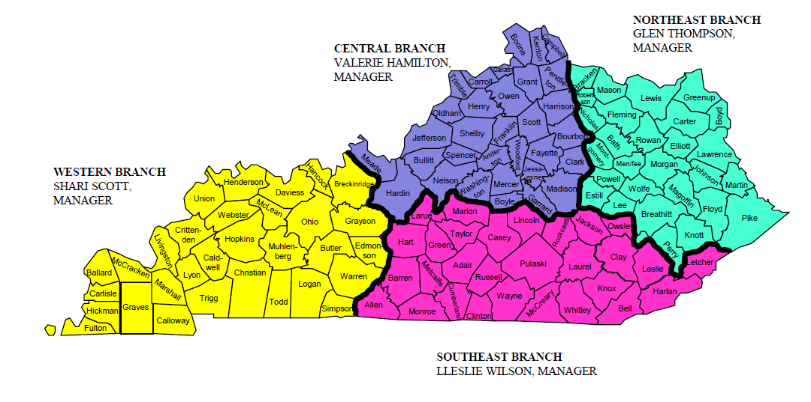
APA Local Government Audit Branches

Slide 36
Contact Information:
Auditor of Public Account Office
  (502) 564-5841
Northeast Branch – Glen Thompson
  Ext. 2919 glen.thompson@ky.gov
Central Branch – Valerie Hamilton
  Ext. 2862 valerie.hamilton@ky.gov
Western Branch – Shari Scott
  Ext. 2881 shari.scott@ky.gov
Southeastern Branch – Lleslie Wilson
  Ext. 2886 lleslie.wilson@ky.gov

Slide 37
Contact Information:
Quality Assurance Branch Manager – Liz Lowe
  Ext. 2926 Liz.Lowe@ky.gov
Executive Director – Jim Royse
  Ext. 2924 James.Royse@ky.gov
Deputy State Auditor – Shawnna Crouse
  Ext. 2902 Shawnna.Crouse@ky.gov

