Slide 1
Prosecutors Advisory Council & Staff
Your Partners in Administration

Slide 2
Duties of Prosecutors Advisory Council
The Prosecutors Advisory Council by statute administers the Unified Prosecutorial System. This includes:
Budget
Staffing
Continuing Legal Education
Program Development

Slide 3
UNIFIED PROSECUTORIAL SYSTEM
120 County Attorneys
57 Judicial Circuits = 57 Commonwealth’s Attorneys
Circuits Consist of 1 to 4 Counties
56 of 57 are considered “Full-time” and cannot practice privately
Approximately 1,275 employees total
Commonly referred to as the UPS

Slide 4
Members- total 13
Commonwealth’s | County
1st-19th circuit | Population >/=75k
20th-38th circuit | Population >25k but <75k
39th-57th circuit | Population < 25k
2 at large from any circuit | 2 at large from any county
1 non attorney citizen members- nominated with 3 names by CWA (AG appoints) | 1 non attorney citizen member – nominated with 3 names by CAA (AG appoints)
Attorney General - Chair
2 year terms for members, no more than 2 consecutive terms
Notes:
The members are nominated by the Associations.

Slide 5
Prosecutors Advisory Council as of January 2025
Chair
Attorney General Russell Coleman
County Attorney members
Commonwealth’s Attorney Members
Jenny Oldham – Hardin Co
Joe Ross – Logan Co
Jennie Haymond – Madison Co
John Estill – Mason Co
Martin Hatfield – Pulaski Co
Courtney Baxter – 12th JC
Rob Sanders – 16th JC
Jackie Steele – 27th JC
Brian Wright – 29th JC
Carrie Ovey-Wiggins – 56th JC
Citizen Members
Lisa Foley & Margaret Daniel

Slide 6
This is the UPS

Slide 7
We’re NOT AOC
AOC = The Administrative Office of the Courts
Judicial Branch/Judicial Budget
CourtNet 2.0
Judges and Clerks
UPS
Executive Branch/General Government
Part of the Governor’s Budget
Commonwealth’s and County Attorneys

Slide 8
Bobby Stokes, Executive Director pac staff member since 2007

Slide 9
PAC Staff
Gina Carey – Executive Budget and Policy Director
Alyssa Logan – Assistant Budget Advisor
Madeline Wise – Executive Assistant
Terri Jacobs – CSA Data Collector
Carol Ray – Rocket Docket Data Collector
Susan Blake – Prosecutor Training Director
Matt Moye – Administrative Assistant
Bobby Ripy – Information Technology Director
Justin Perry, Josh Hatfield and Brandon Woods – Techs
Chad Coleman – Case Management Application Specialist
Julie Cox – Human Resources Director

Slide 10
PAC Staff
Penny Quatman – Fiscal Manager
Vacant – Fiscal Administrative Assistant
Mike Carr – IT Procurement
Tricia Wise – Division Administrative Support/Supplies and Printing
Vacant – Grant and Travel Administrator
Samantha Bracco – Human Resource Generalist
Vacant – HR Administrative Specialist
Jenny True – Traffic Safety Resource Prosecutor
Gail Whitt – Admin Assistant
Tom Lockridge – Violent Crimes Resource Prosecutor
Kathy Phillips – Domestic Violence Resource Prosecutor
Harry Rothgerber – PAC Legislative Research Attorney

Slide 11
What do we do for you?
Personnel/Payroll
Budget
Appointments/Position Changes/Separations
Health/FSA/Life/Other Insurance
Process payroll
Answer your questions
Set and administer Personnel and Operating Budgets
Submit Biennial Budget requests appropriations in the Executive Budget Bill

Slide 12
What do we do for you?
Pay the bills
Purchasing
Process Payments for
Leases
Utilities
Legal Research
Travel
Supplies
IT Equipment/Software
Furniture
Reimbursements
Work with Finance Cabinet to establish and change leases
Copier leases
Large project contracts like Case Management
Determines if/how to purchase needs for the offices

Slide 13
What do we do for you?
Manage funds
Authorize Purchases
Administer Grant funding
Account for Asset Forfeiture funds received and expended
Account for Equitable Sharing funds
Administer local grants to pay or supplement salaries
Provide pre-approval for
Out of State Travel
Expert Witnesses
Interpreters
Use of AF funds
Misc Emergency Purchases

Slide 14
What do we do for you?
training
Support the Council
Develop and Provide Trainings such as :
Annual Kentucky Prosecutors Conference
Kentucky Prosecutors Institute
Jury Instruction and other Trial Advocacy
Statutorily mandated topics
Prepare and compile topics/requests for Council meetings
Provide administrative support to the Council

Slide 15
What do we do for you?
Questions/Guidance
Support info tech
Provide guidance on topics such as:
Legislation
Budget
Salary Classification and Compensation
Case Law
Respond to Open Records Requests
Assist with Victim Witness Protection Claims
Administer Email, Office 365, CourtNet, Westlaw accounts
Provide help desk services for supported IT
Manage local networks and Cloud storage
MUCH MUCH MORE

Slide 16
Training
2025 Kentucky Prosecutors Institute
March 10 - 13
Trial Advocacy skills
Perfect for new prosecutors
Limited space
Jury Instruction Training
May 6 - 9
Kentucky Prosecutors Conference
2025 Conference will be at the Lexington Convention Center Aug 20-22
Registration usually announced in early June
Hotel sells out quickly – don’t delay!
Online Video Library for mandatory training topics on the PAC Intranet

Slide 17
Mandatory Training Provided by PAC
Crimes against the Elderly (KRS 15.775)
Domestic Violence (KRS 15.718)
Child Abuse (KRS 15.718)
Human Trafficking (KRS 15.718)

Slide 18
Biennial Budget Process
The Commonwealth of Kentucky normally operates on a two year (biennial) budget cycle.
The Prosecutors Advisory Council submits the budget for the Unified Prosecutorial System. Commonwealth’s and County Attorneys budget units are submitted separately and appropriated separately.
In the spring - you will be required to submit data to support the budget request 2026 Budget Session.

Slide 19
Annual budget process
Each spring the Council sets the budget for the new fiscal year.
Using the appropriation and language from the Executive Budget Bill
Emails regarding requesting additional positions and funds will go out in April-May
Rocket Docket application process around the same time
Each office will submit their new staff salary allocation by a deadline in June to make the salaries effective July 1

Slide 20
What’s in the budget?
PERSONNEL
Personnel funds including salary and fringe for both the elected and staff
Elected Expense Allowance
Salary Classification and Compensation Funds
Rocket Docket Funds
Workers Compensation
Unemployment Claims
AALC Subsidy Funds
Interpreter Fees

Slide 21
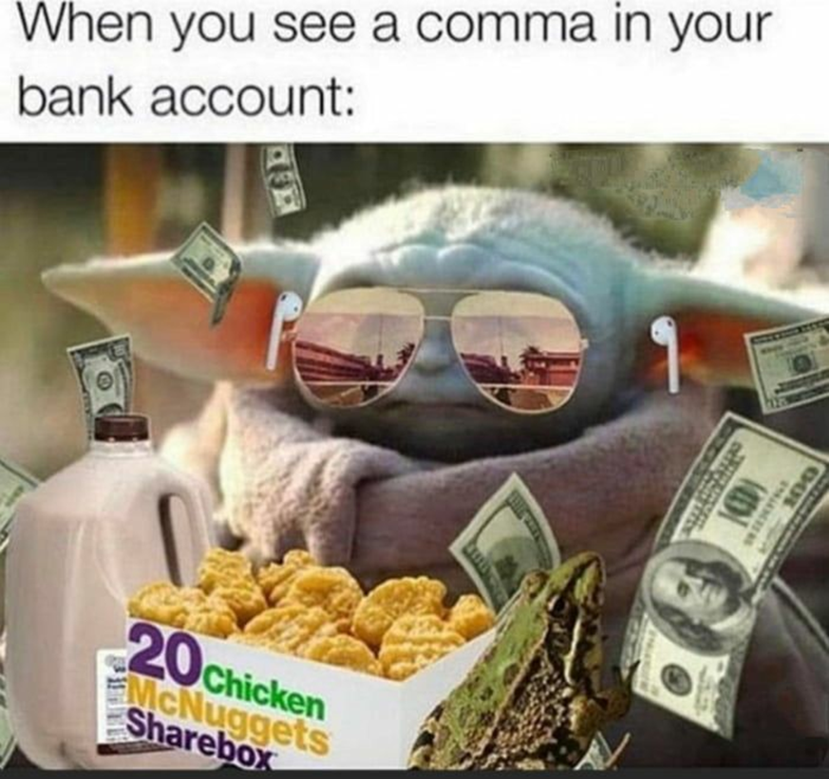
County Attorney Salary Information
State salary for criminal prosecution (for fiscal year 2026 – effective 7/1/25): $94,276.89
State and County Maximum (for calendar year 2025): $158,892.84
Expense Allowance: $500 per month – $6,000 per year
It IS taxed and counts as retirement income
Is NOT counted towards the maximum salary
Notes:
The Department of Local Government Computes the Consumer Price Index by the Second Friday In February. The Salary is Effective Retroactively to January 1.
The Expense Allowance is Considered Income and as Such is Taxed and Retirement Benefits are Withheld

Slide 22
Staff Budgets
Staff budgets are set by the Prosecutors Advisory Council annually from general fund appropriation to UPS through the biennial budget bill
Some factors considered in setting your staff budget:
Available funding
History
Caseload
Population
No. of Judges
Major highways, universities, prisons, etc

Slide 23
Types of Staff Positions
Full Time “FT” – this means that 100% of their time is spent on criminal prosecution. Receives retirement benefits and health/life insurance
Part Time “PT” – 100 hours or more per month – receives retirement benefits and health/life insurance
Quarter Time “LT” – Less than 100 hours per month – no retirement or health/life insurance
Full-time Shared (FTS) –
Employee works for more than one office on the UPS payroll
Has signed an affidavit that they do not have or work for:
Private practice
Child Support
Local Government
Part-time Shared (PTS)
Employee works for more than one office on the UPS payroll
Has not signed the affidavit because they work for:
Private practice
Child Support
Local Government

Slide 24
YOU HAVE TO ASK THE COUNCIL
PAC Must Approve Any Additional Funding including SCCP funding and/or positions to your Staff Budget
PAC Must Approve Changes in Classification of Positions
PAC Must Approve Changes in Status of Positions
PAC Must Approve hiring spouses or family members
PAC Must Approve PAC staff administration of Grant or Supplemental Funding
PAC Must Approve non state funded assistant positions

Slide 25
YOU DO NOT HAVE TO ASK THE COUNCIL
To change the salaries within your office as long as you do not exceed the total amount of your staff salary budget and the total increase allocated to an individual is not more than $10,000 in a fiscal year.
To fill a vacancy in an existing staff position (unless the Council has ordered a hiring freeze or a 30 day waiting period.)

Slide 26
What’s in the budget?
OPERATING
Training
KPC and other PAC sponsored trainings
Software
AntiVirus/Cloud Storage
Insurance for office contents
Criminal Law of Kentucky
CourtNet User fees
Computer Replacements*
Mandated fees for state required systems
Case Management

Slide 27
What’s THE POLICY for the county operating budgets?
Operating funds are approved for PUBLIC SERVICE USE ONLY – items/services purchased or reimbursed from UPS administered funds are prohibited from private use/purposes. Items/services to be purchased or reimbursed require written PRE-APPROVAL from PAC if PAC administered funds are to be used. Child support related expenses are not reimbursable through PAC. Expenses already reimbursed through another fund source are not reimbursable.

Slide 28
What’s in the budget?
INDIVIDUAL OPERATING
Rent/Utilities –
Reimbursable at a rate determined by Real Properties
Utilities reimbursable at the same rate
Affidavits and forms required
Phone Systems/Telephone Bills
Phone systems not located in the same space as a private practice
If purchasing – must be purchased by PAC
Affidavits and forms required for reimbursement
Copier – Lease or Reimbursement (subject to Purchasing regs)

Slide 29
What’s in the budget?
INDIVIDUAL OPERATING
Postage/Printing/Supplies
In-State Travel (typically not for CLE)
Legal Research(WestLaw & Clear)
Courtnet – UPS Staff ONLY
Software Subscriptions/Maintenance – Office 365 – UPS Staff ONLY
Cell Phone & Usage
Reimbursable OR direct payment for a line 100% dedicated to the office for after hours communications and “on-call” employees
Personal cell phone reimbursements up to 50% from Asset Forfeiture with forms
Furniture/Equipment – purchased through PAC for Criminal Prosecution Use

Slide 30
What’s NOT in the budget?
Out of State Training (Not approved by PAC)
Local Bar Dues or Dues to other Criminal Justice Organizations
Personal Cell phones

Slide 31
More Notes about operating
Reimbursements:
Determination of percentages for reimbursements will be recertified on a periodic basis as directed by the Council
Child Support and other already reimbursed expenditures are NOT ALLOWABLE from UPS funds.
The Operating Budget is set at $8,000. It cannot be reallocated to Personnel and vice versa.

Slide 32
Technology
If you don’t read email, get a staff person who will read emails so that you will know what is going on.
PAC provided computers/equipment must be used for criminal prosecution duties only.
Be aware of phishing emails. When in doubt – assume it’s bad.
USE THE HELP DESK EMAIL – do not email/call/text staff directly
Do NOT request assistance with personal equipment/software.

Slide 33
CourtNet 2.0
PAC Administers users accounts for Unified Prosecutorial System employees ONLY
Elected officials must request accounts for UPS employees
It’s not free - $10/user/month – included in the budget

Slide 34
PAC Intranet
All PAC forms available on Intranet
All Application packets must be UPLOADED at the link on the Intranet
Most email alerts posted to Intranet too
Information on Trainings, Deadlines, Breaking News, etc
Resources galore!
Operating and Asset Forfeiture Account information
Access Web Email – all UPS employees can use (jdoe@prosecutors.ky.gov)
All UPS employees can have an Intranet Account

Slide 35
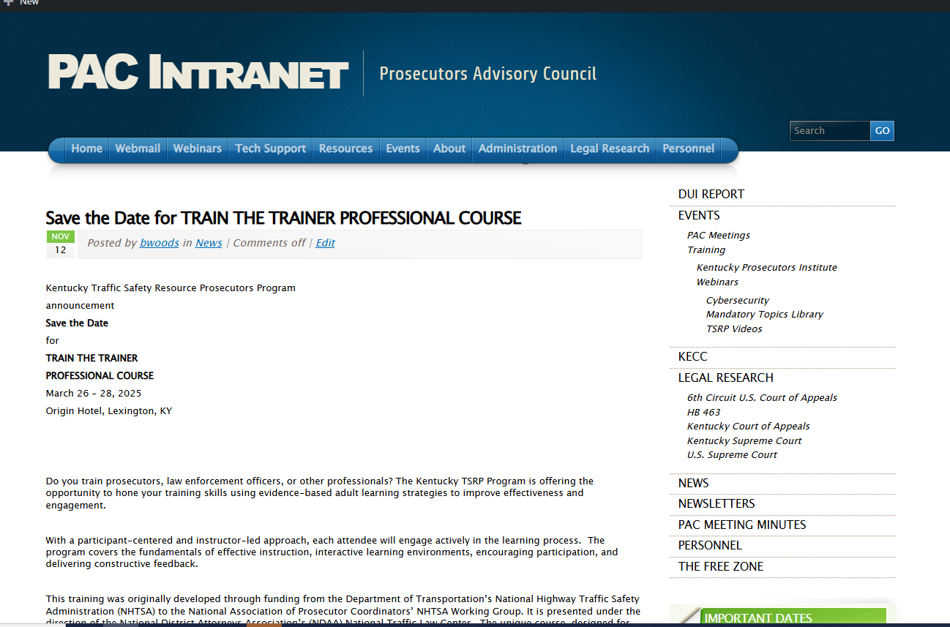

Slide 36
Inventory
Items purchased through PAC MUST be used for criminal prosecution duties ONLY
If items are broken/obsolete and you wish to discard – check with PAC staff first
Computer towers must be returned to PAC
Items cannot be “purchased” for use by private entities
Items can be donated with proper approvals
Computers are purchased with 5 year warranties – contact PAC before ordering service or replacing/taking out of service

Slide 37
So you need something?
Supplies
Email Supplies@prosecutors.ky.gov
One account per office for
Office Depot
Baumannn (Janitorial)
Send orders no more than monthly
Prior approval and/or AF needed for items not on contract
Printing
Send letter requesting and SAMPLE via email to: Supplies@prosecutors.ky.gov
Postage
Send request to Bills@prosecutors.ky.gov
Can use Stamps.com

Slide 38
So you need something else?
Equipment
Email Mcarr@prosecutors.ky.gov – he will advise you on how to request
If the cost of the equipment will exceed your budget, include an AF expenditure form (if you have funds)
Computers/Laptops are only replaced when requested and they’ve reached end of warranty period
Furniture
Send email to: Supplies@prosecutors.ky.gov
Something else? Email BStokes@prosecutors.ky.gov

Slide 39
Got a bill?
All bills to be paid from your operating should be forwarded to Bills@prosecutors.ky.gov.
Initial to show you have reviewed and approve.
Got a bill and you don’t know why? Email Bills@prosecutors.ky.gov
Got a bill for subpoenaed records? Email Bstokes@prosecutors.ky.gov
Did you buy or pay for something for the office WITH pre-approval? Send a completed expense reporting form (on Intranet), a copy of the pre-approval and a DETAILED receipt for reimbursement. This form only works for the elected official.
Did you order or pay for something and forget to get PAC approval? That bill might be yours to pay. Email Bstokes@prosecutors.ky.gov

Slide 40
Travel Vouchers
Submit to Travel@prosecutors.ky.gov
Travel reimbursement from home to office prohibited.
Always fill out To & From.
When Overnight stays – must include travel times (Depart/Arrive)
Always submit itemized receipt
Signature of submitted and Elected required

Slide 41
Legal research
WestLaw account for each office
CLEAR – one user per office
Criminal Law of Kentucky
Sent each Nov/Dec
May request additional
Other – if budget allows
Ky Domestic Relations
Ky Driving Under the Influence
Other??? You tell us.

Slide 42
Still have questions?
Check the Administrative Manual
Check the PAC Intranet
Email PAC@prosecutors.ky.gov or your favorite PAC Staff Person

Slide 43
Remember this
Submit biennial budget data when requested.
Call PAC staff before committing funds or making changes.
READ your email and notify PAC staff if any contact information changes.
Pay attention and submit requested information by the deadlines.
Attend PAC meetings when you can. Be engaged with the Associations and your local legislators.
ASK PERMISSION NOT FORGIVENESS!
Notes:
Respond to the call for help
It’s better to be safe than sorry

Slide 44
Final tips & takeaways
If you aren’t 100% positive of the answer…
ASK US
Please for the love of all things good and holy – just ask.

Slide 46
What is the SCCP?
Result of legislation 2020 session
Compiled in 2020 – members included both Commonwealth’s and County Attorneys
Included a plan for reclassification of the employees of the UPS
Attract talent and retain the highest quality individuals
SCCP = Salary Classification and Compensation Plan

Slide 47
SCCP – Implementation in FY25
Funded in the 2024 session for FY25 & FY26
Council developed an implementation plan and policies for both Commonwealth’s and County Attorneys
Each Elected Commonwealth’s and County Attorney was required to request reclassification of their current staff within the new classification plan
Requirements include
Years of Experience in the UPS or DPA
Some exceptions to the Plan were granted on a case by case basis

Slide 48
IMPORTANT!!
Funding is used SOLELY to supplement salaries to ensure the employee in the classification is receiving the minimum for their classification.
Funding is LIMITED and separately accounted.
NOT part of the individual budget.

Slide 49
SCCP Policies
Quarter-time (QT) status is not covered by the Plan.
SCCP funding is used ONLY to bring a salary to the minimum for the classification and status.
Allocating funding to someone receiving SCCP funds will result in first offsetting any subsidy.
Urban Adjustment – Minimum salaries for circuits 16, 17, 22, 30, and 54 are increased by $7,000 for FT and $3,500 for PT.
Upgrades to classifications require a request to the Council. An employee is not automatically upgraded when they reach the next level due to service time.

Slide 50
One more time in case you forget
SCCP Funds CANNOT BE ALLOCATED by the Elected Official.
Upgrades are NOT automatic.
Allocating any funds to a person in a position receiving SCCP funding will result in first offsetting the supplement from SCCP.

Slide 51
The Shared Employee
KRS 15.725
In the UPS – employee who works for more than one Commonwealth’s or County Attorney simultaneously.
Statuses = Full-time Shared or Part-time Shared
FTS subject to same combined minimum salary as a Full-time position per the scale.
PTS subject to the same combined minimum salary as a Part-time positions per the scale.
Offices must re-certify to PAC the percentage of time the employee works for each office.

Slide 52
IMPORTANT!!
Individuals employed in FTS and PTS positions who resign from one or more offices will not automatically receive a SCCP subsidy or increase in subsidy if the salary drops below the minimum for their classification.
SCCP funding or increase in funding must be approved by the Council.
The elected official for which the employee works must submit the request to be considered at the next PAC meeting.

Slide 54
How can I get more money in my Personnel Budget?
Additional funds may be available in the beginning of a new fiscal year.
The Council will direct an email communication to the offices with a deadline to respond.
Don’t miss the deadline.
Do respond with both a specific request and justification for the request.
Remember, there is a limited amount of funding and 119 other offices likely vying for that same funding.
Make sure to always submit your Biennial Budget Request survey with complete and accurate data.

