Slide 1

Engaging Youth Through the Lens of Brain Development and Trauma Within the Court System
Kimberly Brothers-Sharp, LCSW
Julie Horen-Easley, MPH
January 2026
©2026 Aetna Inc. Confidential and proprietary.

Slide 2

Agenda
Why Court Professionals Should Be Aware of Brain Science & Trauma
Trauma in the Courtroom
De-escalation
Questions
2
©2026 Aetna Inc. Confidential and proprietary.

Slide 3

Insights from brain science
Why Courts Should Care About Brain Science & Trauma
Impact on legal decisions
Trauma and behavior misinterpretation
Promoting fair justice
3
©2026 Aetna Inc. Confidential and proprietary.

Slide 4
Understanding Brain Development & Trauma

Slide 5
WHAT IS TRAUMA?
The same event can be experienced, adapted to, and carried forward in different ways by different children. So, it is the response (the experience') of the individual to the event that alters the stress response systems and makes something " traumatic" - not simply the event itself.
SAMSHA suggests thinking about the 3 E's...
Three E Framework
" Traumatic" Event (the nature, timing and pattern)
" Traumatic" Experience (individual's response & perception)
Effects of" Trauma" (the long-term impact on the individual)
©2026 Aetna Inc. Confidential and proprietary.

Slide 6


Trauma is an emotional response to an event that threatens or causes harm
What is Trauma?
Physical or emotional
Real or perceived
Threaten directly or indirectly
Single or multiple events
What is Trauma? - YouTube
©2026 Aetna Inc. Confidential and proprietary.

Slide 7
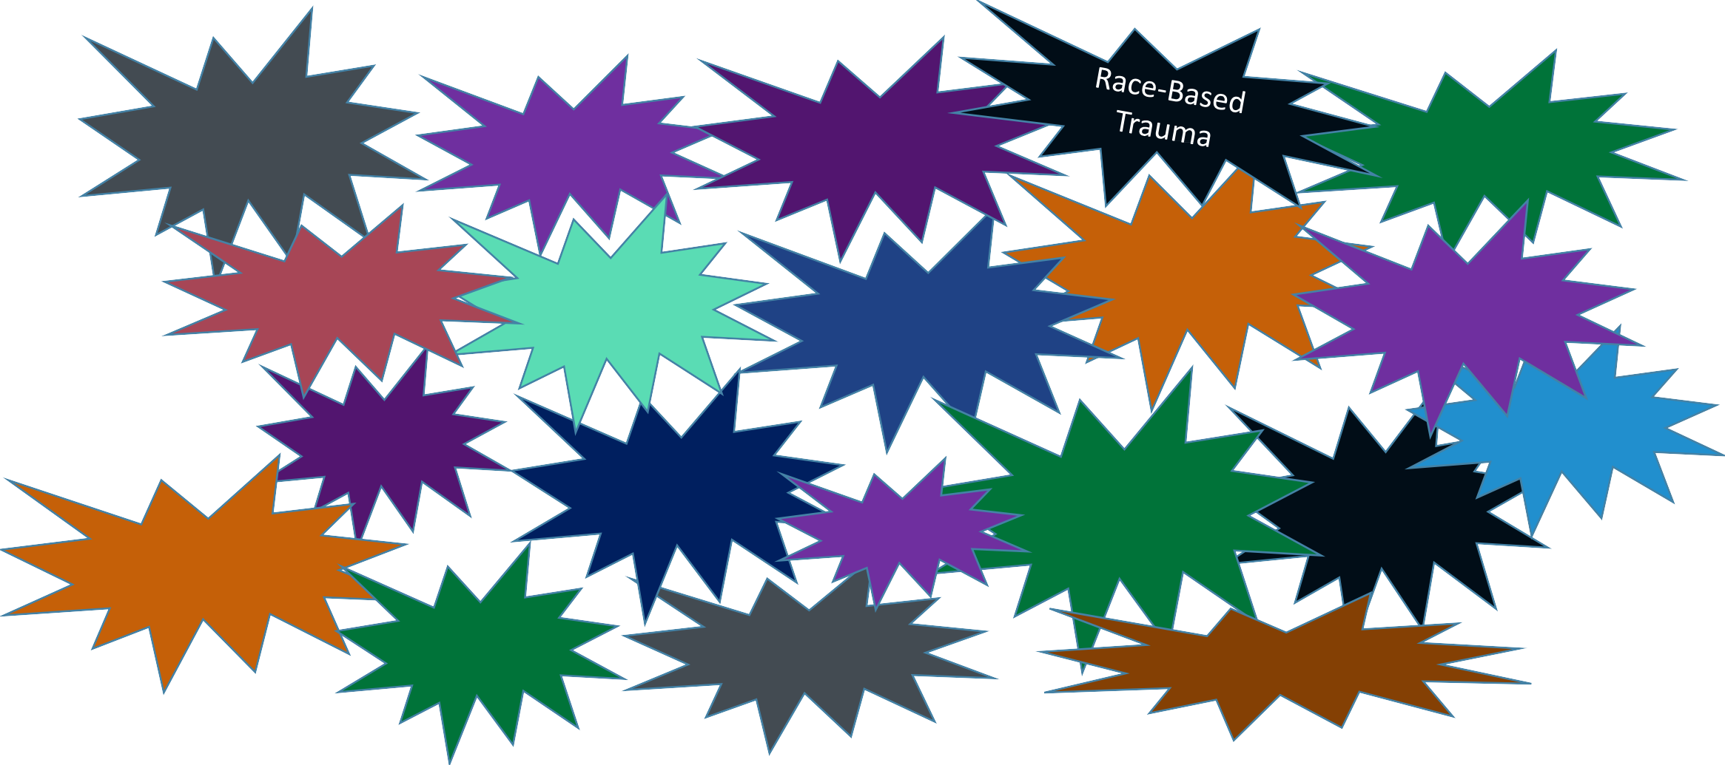
Types of Trauma
Sexual
Assault
Arrest or Incarceration
Bullying
Terrorism
Natural Disaster
Domestic Violence
Historical Trauma
Sexual Abuse
Car Accident
School
Violence
Neglect
Emotional Abuse
Separation from Family
Medical Illness or Procedure
Community Violence
War
Human Trafficking
Forced
Displacement
Microaggressions
©2026 Aetna Inc. Confidential and proprietary.

Slide 8
Adverse Childhood Experiences (ACEs)
8
A
traumatic event
“Childhood experiences are powerful determinants of who we become as adults”
Without help managing the trauma, hard to heal
Most people endure multiple
Impacted over a long period of time
The Body Keeps the Score Animated Book Summary -
YouTube
©2026 Aetna Inc. Confidential and proprietary.

Slide 9



Understanding the Brain
Brain develops from the bottom up
Abstract thought
The lower areas of the brain mediate the more primitive body-based functions
Cortex
Concrete Thought
Affiliation/ reward " Attachment" Sexual Behavior
Emotional Reactivity Motor Regulation
" Arousal" Appetite/ Satiety
The higher levels of the brain are responsible for more intricate functions
Limbic
Diencephalon
DA
NE
Sleep
Brainstem Cerebellum
SER
All rights reserved C 2007-2017 Bruce D. Perry
Blood Pressure
Heart Rate Temperature
To the rest of body via neuroendocrine & neuroimmune systems
To body via ANS (parasympathetic & sympathetic nervous systems)
9 ©2026 Aetna Inc. Confidential and proprietary.
All rights reserved © 2007-2017 Bruce D. Perry

Slide 10
Neurosequential Model of Development: Dr. Bruce Perry
Organizes a child’s history
Both trauma and relationships have impact on
a child’s body and brain
This begins in utero and has long lasting effects
Brain development and effect of trauma
©2026 Aetna Inc. Confidential and proprietary.

Slide 11

The 3 R’s Framework
Regulation
Rewards
Relationships
©2026 Aetna Inc. Confidential and proprietary.

Slide 12
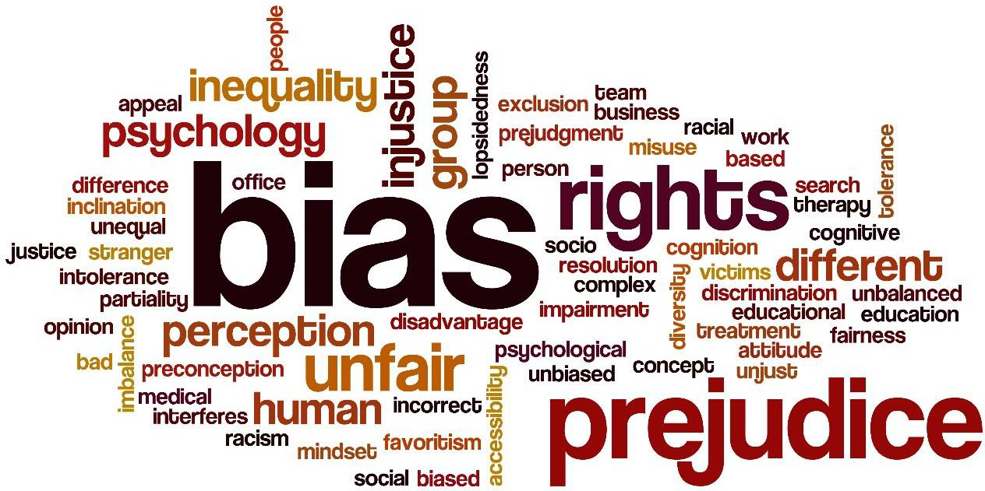
Understanding Implicit and Explicit Bias
Write down three biases that you hold.
©2026 Aetna Inc. Confidential and proprietary.

Slide 13
Court can be frightening—especially for children
Trauma may appear as anger, silence, or confusion
Perspective
Responding with patience and calm helps de-escalate
©2026 Aetna Inc. Confidential and proprietary.

Slide 14
Trauma in the Courtroom

Slide 15
Trauma Informed Prosecutions
Role of prosecutors:
Primary decision-makers at key points; ability to mitigate inequities and re-traumatization
Core skills:
Recognize signs; assume under-reporting; use unbiased screening; partner with advocates; ensure culturally responsive referrals
System health:
Support staff resilience; address secondary traumatic stress;
maintain ongoing training

Slide 16
Shift the lens:
Ask 'What happened to you?' rather than 'What is wrong with you?'
Reframe to Understand
Curiosity prompts:
'What do you think brought you to this point?'

Slide 17
Explain procedures, decisions, and next steps in plain language
Transparency Increases Compliance
Invite participation with simple questions; repeat key orders

Slide 18
Design the Room for Safety
Seat | Seat victims away from alleged abusers; separate families with children
Keep | Keep noise low; avoid nonverbal intimidation (e.g., jingling keys, crowding)
Respect | Respect personal space; consider selective use of robes

Slide 19
1 2
Scheduling & Appearance Options
3
Docket to minimize wait times and limit child exposure to traumatic testimony
Use online appearances when appropriate to reduce barriers and intimidation
Provide clear signage and simple courthouse rules

Slide 20
Assessments Before Treatments
Trauma can mimic ADHD, bipolar disorder, or conduct disorder
Order trauma assessments; tailor treatment to findings
People are resilient and can heal with proper support

Slide 21
De-escalation: Judicial Communication
Listen | Listen without judgment; allow time for each speaker to be heard
Use | Use open posture; appropriate eye contact; reflect and paraphrase
Label | Label emotions gently; inform consequences—do not threaten
Call | Call a recess to allow self- regulation when needed

Slide 22
Language Shifts That Help
Instead of:
Instead of:
Instead of:
Instead of:
'He is making it up.'
Try: 'Trauma is difficult to talk about.'
'Seeking attention.'
Try: 'He is communicating needs in learned ways.'
'Dirty screen.'
Try: 'Your test shows the presence of substances.'
'We are done with you.'
Try: 'We may need a different way to support you.'

Slide 23
Acknowledging Trauma (Examples)
'Something bad happened. It's not your fault. You deserve to be safe.'
'I can connect you with someone who can help—would that be useful?'

Slide 24
Trauma, Memory Recall & Witness Testimony
EXPECT NON-LINEAR, SENSORY-BASED RECALL; ALLOW TIME
INCONSISTENCIES CAN REFLECT NEUROBIOLOGY, NOT DECEPTION
USE OPEN-ENDED QUESTIONS; AVOID RAPID-FIRE; CLARIFY WITHOUT CONFRONTATION

Slide 25
De-escalation

Slide 26

De-escalation: Judicial Communication
Listen without judgment; allow time for each speaker to be heard
Use open posture; appropriate eye contact; reflect and paraphrase
Label emotions gently; inform consequences—do not threaten
Call a recess to allow self-regulation when needed

Slide 27

Building Rapport to Support Victims & Justice
Transparent explanations
(what/why/what’s next)
Set Clear Expectations
Normalize reactions; acknowledge effort and progress
Offer advocates; connect to services; set clear, achievable conditions
Relationship

Slide 28
Why Compassion Strengthens Justice
Improves accuracy and participation
Reduces secondary victimization and disruptions
Builds trust in the courts; supports long-term stability

Slide 29
QUESTIONS

Slide 31
Selected References & Kentucky Resources
CSG Justice Center (2025): Kentucky DV findings and
recommendations
KRS 421.500–421.575; KRS 421.576 (Crime Victim Bill of Rights); Marsy's Law (2020)
KY AOC Specialty Courts & Behavioral Health Liaisons; Veterans Treatment Court; Family Recovery Court
Office of Victims Advocacy; VOCA programs; VINE; Crime Victims Compensation
Neurosequential Model of Therapeutics (Regulate–Relate–Reason)
31
©2026 Aetna Inc. Confidential and proprietary.

