Slide 1


Slide 2

Unclaimed Property in the Commonwealth of Kentucky
Presentation by: Robert L. Gullette III, Deputy General Counsel Jim Florence, Director of UCP

Slide 3
What is Unclaimed Property?
Unclaimed Property (also referred to as abandoned property) includes various assets, like money, securities and even physical property often held by financial institutions, companies and governmental units.
What are the statutes that govern Unclaimed Property in the Commonwealth?
KRS Chapter 393A governs the administration and reporting of Unclaimed Property in Kentucky.
Who is obligated to report and comply with KRS 393A?
Any person holding property of another, including money for which there is a corresponding obligation to pay or deliver said property to the owner.

Slide 4
What is Unclaimed Property?
Unclaimed Property (also referred to as abandoned property) includes various assets, like money, securities and even physical property often held by financial institutions, companies and governmental units.
What are the statutes that govern Unclaimed Property in the Commonwealth?
KRS Chapter 393A governs the administration and reporting of Unclaimed Property in Kentucky.
Who is obligated to report and comply with KRS 393A?
Basically, everyone.

Slide 5
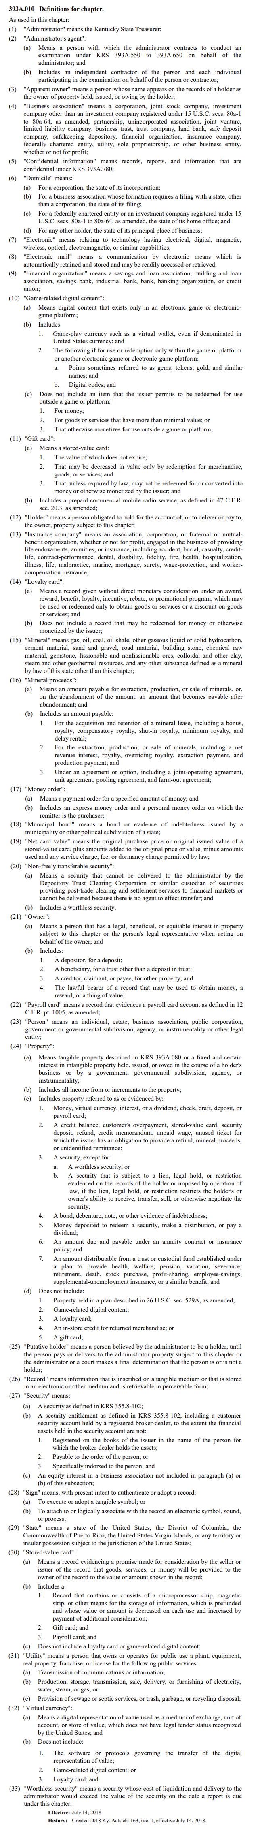
Important Definitions:

Slide 6
Important Definitions:
"Apparent owner" means a person whose name appears on the records of a holder as the owner of property held, issued, or owing by the holder;
"Owner":
(a) Means a person that has a legal, beneficial, or equitable interest in property subject to this chapter or the person's legal representative when acting on behalf of the owner; and
(b) Includes:
1. A depositor, for a deposit;
2. A beneficiary, for a trust other than a deposit in trust;
3. A creditor, claimant, or payee, for other property; and
4. The lawful bearer of a record that may be used to obtain money, a reward, or a thing of value;
"Holder" means a person obligated to hold for the account of, or to deliver or pay to, the owner, property subject to this chapter;

Slide 7
Important Definitions:
"Property":
(a) Means tangible property described in KRS 393A.080 or a fixed and certain interest in intangible property held, issued, or owed in the course of a holder's business or by a government, governmental subdivision, agency, or instrumentality;
(b) Includes all income from or increments to the property;
(c) Includes:
1. Money, virtual currency, interest, or a dividend, check, draft, deposit, or payroll card;
2. A credit balance, customer's overpayment, stored-value card, security deposit, refund, credit memorandum, unpaid wage, unused ticket for which the issuer has an obligation to provide a refund, mineral proceeds, or unidentified remittance;
3. A security, except for:
a. A worthless security; or
b. A security that is subject to a lien, legal hold, or restriction evidenced on the records of the holder or imposed by operation of law, if the lien, legal hold, or restriction restricts the holder's or owner's ability to receive, transfer, sell, or otherwise negotiate the security;
4. A bond, debenture, note, or other evidence of indebtedness;
5. Money deposited to redeem a security, make a distribution, or pay a dividend;
6. An amount due and payable under an annuity contract or insurance policy; and
7. An amount distributable from a trust or custodial fund established under a plan to provide health, welfare, pension, vacation, severance, retirement, death, stock purchase, profit-sharing, employee-savings, supplemental-unemployment insurance, or a similar benefit; and …

Slide 8
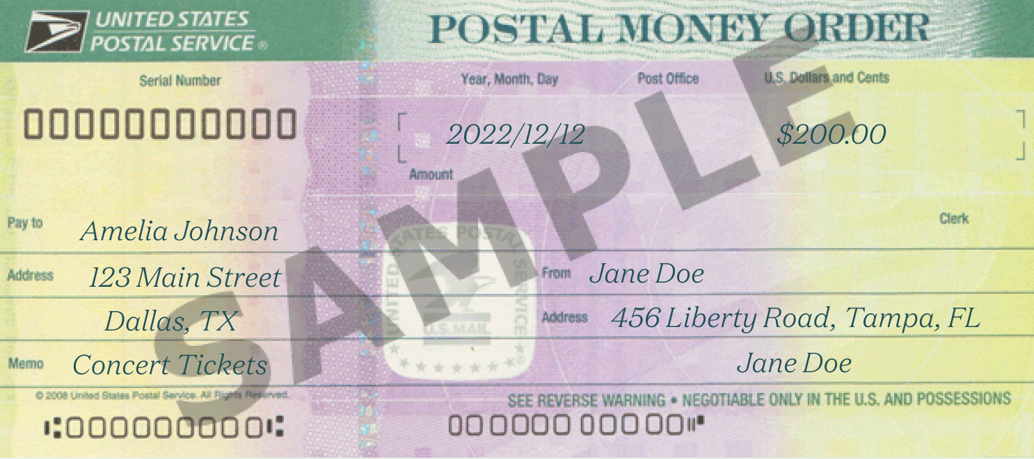
When property presumed abandoned. (KRS 393A.040)
Property shall be presumed abandoned if it is unclaimed by the apparent owner during the period specified below:
Money Order:
7 Years

Slide 9

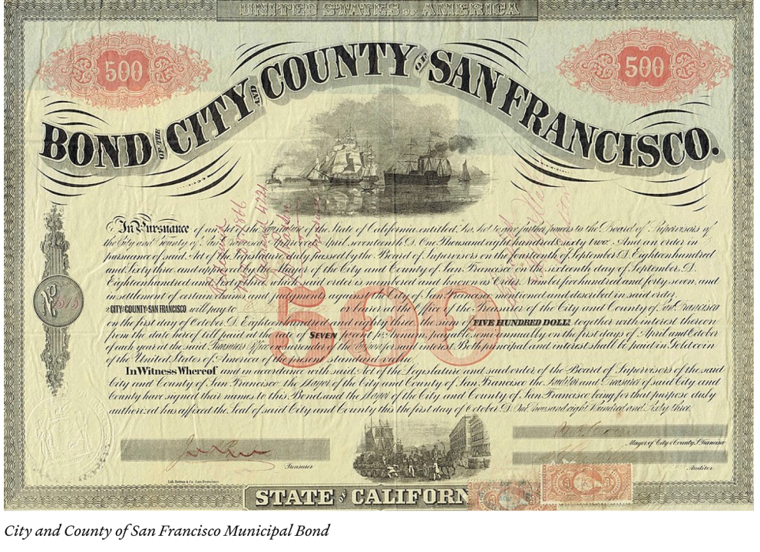

When Property Presumed Abandoned (KRS 393A.040)
Property shall be presumed abandoned if it is unclaimed by the apparent owner during the period specified below:
State, Municipal or Bearer bond
Payroll card
Debt of a business association
3 Years
3 Years
3 Years

Slide 10

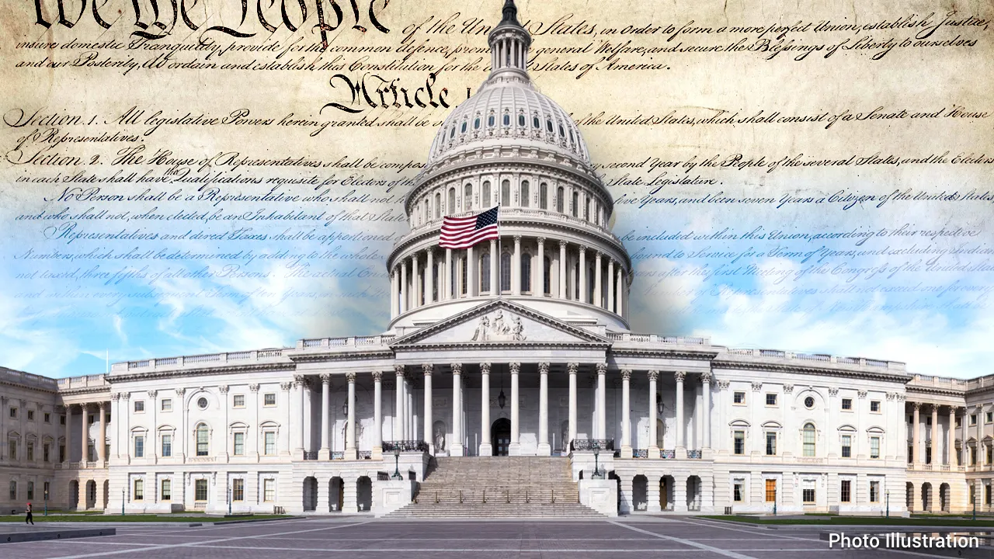

When Property Presumed Abandoned (KRS 393A.040)
Property shall be presumed abandoned if it is unclaimed by the apparent owner during the period specified below:
Wages, commissions, etc:
1 year
Property held by Government:
1 year
Property held by a Court:
1 year

Slide 11

When Custodial Account for Minor Presumed Abandoned (KRS 393A.070)
Property held in an account established under KRS 385.012 to 385.242, shall be presumed abandoned three (3) years after the later of:
(a) the date a second consecutive communication sent by the holder to the custodian is returned undelivered;
(b) If the second communication is sent later than thirty (30) days after the date the first communication is returned undelivered, the date the first communication was returned undelivered; or
(c) The date on which the custodian is required to transfer the property to the minor in accordance with the Uniform Gifts to Minors Act or Uniform Transfers to Minors Act.

Slide 12


Holder Responsibilities (KRS 393A.220)
A Holder has two (2) responsibilities:
FIRST:
The Holder shall report the abandoned property in a timely, complete and accurate manner.
SECOND:
The Holder shall pay or deliver the abandoned property to Treasury.
Property reportable and payable or deliverable absent owner demand. (KRS 393A.260)
Property shall be reportable and payable or deliverable under this chapter even if the owner fails to make demand or present an instrument or document otherwise required to obtain payment.

Slide 13


When Report to be Filed (KRS 393A.240)
Holder Reports shall be filed on:
Unless you are an insurance company….
November 1st
May 1st
And cover the twelve months preceding July 1 of that year
And cover the preceding calendar year

Slide 14

Content of Holder Report (KRS 393A.230)
Holder Reports shall:
1. Be signed by the holder and verified as to completeness;
2. Be filed in an approved electronic format;
3. Accurately describe the property;
4. Contain the information necessary to identify the owner;
5. State the commencement date for determining abandonment; and
6. State that the holder has complied with notice requirements (KRS 393A.270).
Additional obligations:
For Safety Deposit Boxes:
Indicate the location of the property where it can be inspected
Specify amounts owed to the holder.
For subsequent holders and holders that have changed their name:
Include the former name or names of the holder(s); and
Provide known address of each previous holder.

Slide 15
Retention of Records by Holder (KRS 393A.250)
A holder is required to retain records for ten (10) years after the filing of the report. The records must contain the following:
1. The information required to be in the report.
2. The date place and nature of the circumstances that gave rise to the property right.
3. The amount or value of the property.
4. The last address of the apparent owner, if known, and
5. If the holder sells traveler’s checks, money orders or similar instruments within the Commonwealth, they must retain a record of the instruments while they remain outstanding which indicates the state and date of issue.
Failure to retain records by examined person (KRS 393A.600)
If a person does not retain the records, the administrator may determine the value of property due using a reasonable method of estimation based on all information available to the administrator.

Slide 16

Notice of Apparent Owner by Holder (KRS 393A.270)
The holder shall send notice to the apparent owner by first class mail between 60 and 180 days prior to the filing of the report if:
1. The holder has in its records an address for the apparent owner; and
2. The value of the property is fifty dollars ($50.00) or more.
If the owner has previously consented to receiving e-mails, the holder will send the same notice by email as well.

Slide 17

Contents of Notice by Holder (KRS 393A.280)
The Notice shall contain a heading that reads substantially as follows:
"Notice. The Commonwealth of Kentucky requires us to notify you that your property may be transferred to the custody of the Kentucky State Treasurer if you do not contact us before (insert date that is thirty (30) days after the date of this notice)."
The Notice shall also:
Identify the nature and value of the property;
State that the property shall be turned over;
State that after the property is turned over, an apparent owner can make a claim for its return;
State that the property may be sold by the administrator; and
Provide instructions that the owner shall follow to prevent the holder from reporting and delivering the property to the administrator.

Slide 18

Verified Report of Property (KRS 393A.550)
If a person does not file a report or the administrator believes that a person may have filed an inaccurate, incomplete, or false report, the administrator may require the person to file a verified report.
The verified report shall:
(1) State whether the person is holding property reportable under this chapter;
(2) Describe property not previously reported or about which the administrator has inquired;
(3) Specifically identify property about which there is a dispute whether it is reportable under this chapter; and
(4) State the amount or value of the property.
Examination of records to determine compliance. (KRS 393A.560)
The administrator, at reasonable times and on reasonable notice, may:
(1) Examine the records of a person;
(2) Issue an administrative subpoena; and
(3) Bring an action seeking judicial enforcement of the subpoena.

Slide 19
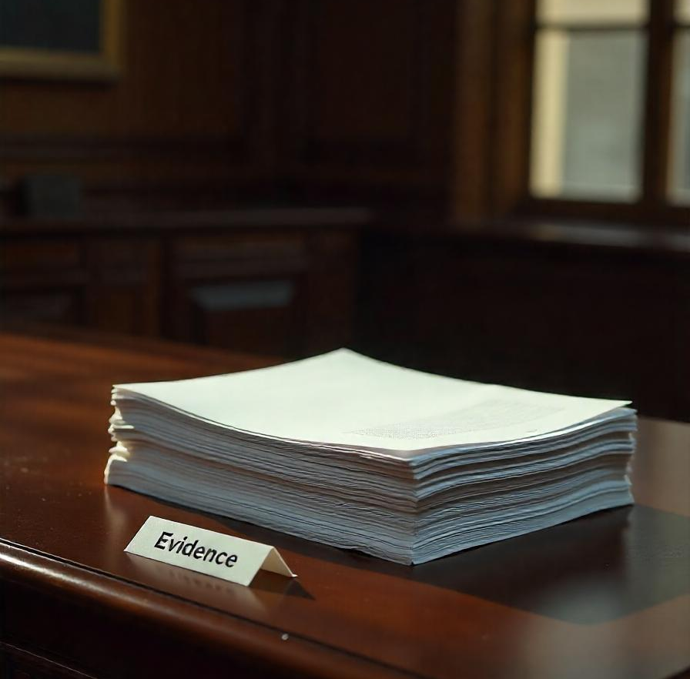
Evidence of Unpaid Debt or Undischarged Obligation (KRS 393A.590)
A record of a putative holder showing an unpaid debt or undischarged obligation shall be prima facie evidence of the debt or obligation.
A putative holder may overcome prima facie evidence section by establishing by a preponderance of the evidence that a check, draft, or similar instrument was:
(a) Issued as an unaccepted offer in settlement;
(b) Issued but later was replaced with another instrument;
(c) Issued to a party affiliated with the issuer;
(d) Paid, satisfied, or discharged;
(e) Issued in error;
(f) Issued without consideration;
(g) Issued but there was a failure of consideration;
(h) Voided not later than ninety (90) days after issuance for a valid business reason; or
(i) Issued but not delivered to the third-party payee.

Slide 20


Effect of Payment or Delivery of Property to Administrator (KRS 393A.340)
A holder that pays or delivers property to the administrator in good faith and substantially complies with KRS 393A.270 and 393A.280 shall be relieved of liability.
Definition of “Good Faith”. (KRS 393A.310)
Payment or delivery of property shall be made in good faith if a holder:
(1) Had a reasonable basis for believing, based on the facts then known, that the property was required to be paid; or
(2) Made payment:
(a) In response to a demand by the administrator; or
(b) Under a guidance or ruling issued by the administrator.
This state shall defend and indemnify a holder against liability…

Slide 21

Determination of Liability for Unreported Reportable Property (KRS 393A.650)
If the administrator determines that a putative holder failed or refused to pay property which is reportable, the administrator shall issue a determination of the putative holder's liability and give notice to the putative holder.

Slide 22

Informal conference (KRS 393A.660)
(1) Not later than thirty (30) days after receipt of that notice, the putative holder may request an informal conference with the administrator to review the determination.
(2) If a putative holder makes a timely request for an informal conference:
(a) Not later than twenty (20) days after the date of the request, the administrator shall set the time and place of the conference;
(b) The administrator shall give the putative holder notice of the time and place of the conference;
(c) The conference may be held in person, by telephone, or by electronic means;
(d) The request tolls the ninety (90) day period for Administrative and Judicial review;
(e) The conference may be postponed, adjourned, and reconvened as the administrator determines appropriate;
(f) The administrator may modify a determination made under KRS 393A.650 or withdraw it; and
(g) The administrator shall issue a decision and provide a copy of the record to the putative holder not later than twenty (20) days after the conference ends.

Slide 23

Review of administrator's determination (KRS 393A.670)
A putative holder may seek relief from a determination under KRS 393A.650 by:
(1) Administrative review under KRS 393A.680; …
Administrative review (KRS 393A.680)
(1) Not later than ninety (90) days after receiving notice of the administrator's determination under KRS 393A.650, a putative holder may initiate a proceeding under KRS Chapter 13B for review of the administrator's determination.
(2) A final decision in an administrative proceeding initiated under subsection (1) of this section shall be subject to judicial review under KRS Chapter 13B.

Slide 24

Review of Administrator’s Determination (KRS 393A.670)
A putative holder may seek relief from a determination under KRS 393A.650 by: …
(2) Judicial review under KRS 393A.690.
Judicial Remedy (KRS 393A.690)
(1) Not later than ninety (90) days after receiving notice of the administrator's determination under KRS 393A.650, the putative holder may:
(a) File an action against the administrator in the appropriate court challenging the administrator's determination of liability and seeking a declaration that the determination is unenforceable, in whole or in part; or
(b) Pay the amount or deliver the property determined by the administrator to be paid or delivered to the administrator and, not later than six (6) months after payment or delivery, file an action against the administrator in the appropriate court for a refund of all or part of the amount paid or return of all or part of the property delivered.

Slide 25
Examination under KRS 393A.560
Finality
Administrator issues a decision pursuant to KRS 393A.660(2)(g)
Administrator provides Examination Report pursuant to KRS 393A.610
And determines holder liability pursuant to KRS 393A.650
Holder initiates Judicial proceeding under KRS 393A.690
20 days
Informal Conference takes place pursuant to KRS 393A.660
90 days
Administrator sets the time and place of the conference pursuant to KRS 393A.660(2)(a)
Holder initiates Administrative proceeding pursuant to KRS 393A.680
Holder’s Decision
W/in 90 days of 393A.610 Report
20 days
Holder requests informal conference pursuant to KRS 393A.660
90 days
30 days

Slide 26

Interest and Penalty for Failure to Act in Timely Manner (KRS 393A.730)
A holder that fails to report, pay, or deliver property within the time prescribed shall pay to the administrator interest at the tax interest rate determined under KRS 131.183 from the date the property should have been reported, paid, or delivered to the administrator until the date reported, paid, or delivered.
The administrator may require a holder that fails to report, pay, or deliver property within the time prescribed to pay to the administrator, a civil penalty of two hundred dollars ($200) for each day the duty is not performed, up to a cumulative maximum amount of five thousand dollars ($5,000).

Slide 27

Other Civil Penalties (KRS 393A.740)
If a holder enters into a contract or other arrangement for the purpose of evading an obligation under this chapter or otherwise willfully fails to perform a duty imposed on the holder under this chapter, the administrator may require the holder to pay the administrator, in addition to interest as provided in KRS 393A.730, a civil penalty of one thousand dollars ($1,000) for each day the obligation is evaded or the duty is not performed, up to a cumulative maximum amount of twenty-five thousand dollars ($25,000), plus twenty-five percent (25%) of the amount or value of property that should have been but was not reported, paid, or delivered as a result of the evasion or failure to perform.
If a holder makes a fraudulent report under this chapter, the administrator may require the holder to pay to the administrator, in addition to interest under KRS 393A.730, a civil penalty of one thousand dollars ($1,000) for each day from the date the report was made until corrected, up to a cumulative maximum of twenty five thousand dollars ($25,000), plus twenty-five percent (25%) of the amount or value of any property that should have been reported but was not included in the report or was underreported.

Slide 28

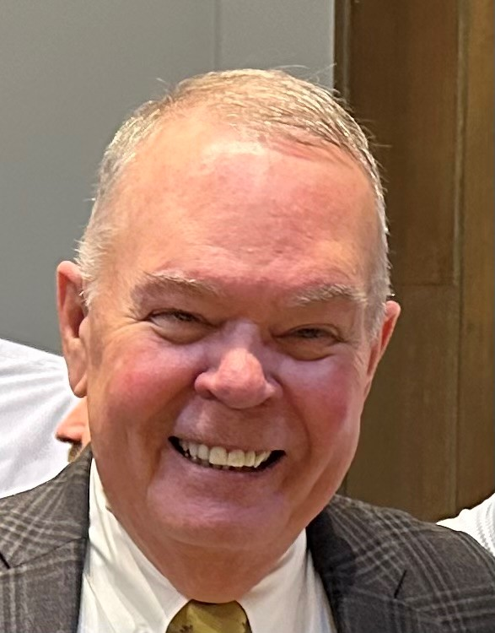

Available Resources:
If you or your clients have questions about filling holder reports, feel free to call or email.
Jim Florence
Director, Unclaimed Property Division
(502) 564-8860
Jim.Florence@ky.gov
Sam Burchett
General Counsel
(502) 564-8820
Sam.Burchett@ky.gov
Robert Gullette III
Deputy General Counsel
(502) 564-8840
Robert.Gullette@ky.gov

Slide 29
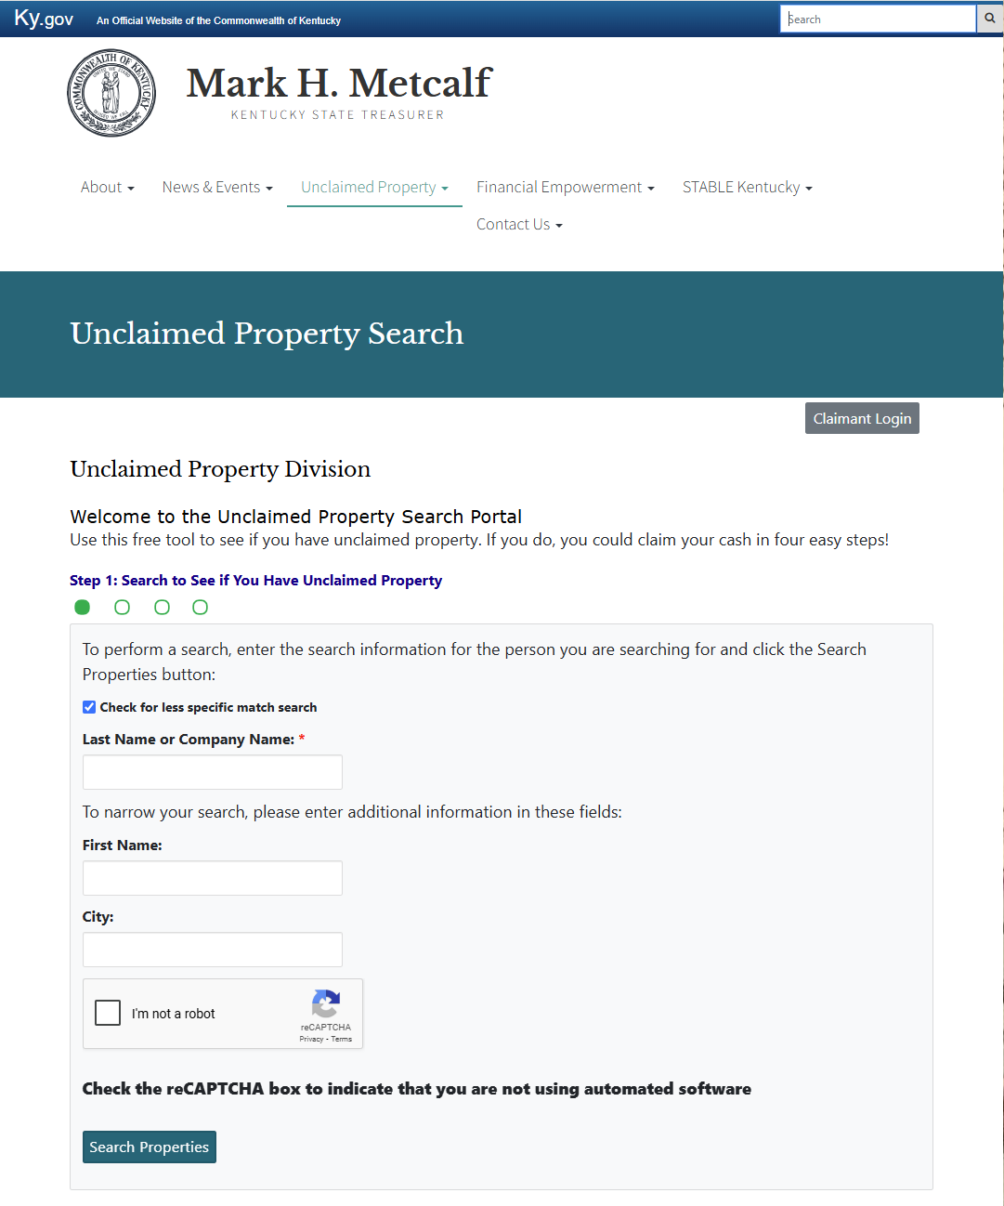
How can Unclaimed Property benefit you and your clients?
The Unclaimed Property Fund has more than $1 Billion dollar in assets. Some of that money may belong to you and your clients. Searching your name and your client’s names can help to reunite them with lost dollars that would be better served in their pockets.
Simply use this web address:
kyclaims.unclaimedproperty.com

Slide 30
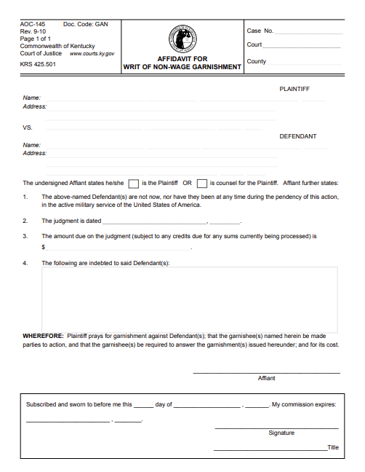
Creditor’s Attorneys, Prosecutors, Family Court Practitioners, Bankruptcy attorneys and any attorney involved in assessing or collecting resources on behalf of a client:
The Unclaimed Property funds are a resource for you and your clients to attach. If you have obtained a Judgment, these funds can be garnished like any other valuable property.
There is more than $1 Billion held by the Treasury and some of it may belong to your county government.
Search for debtors at:
kyclaims.unclaimedproperty.com

Slide 31
Everyone take 2 minutes to search your name, your client’s name or your law firm’s name.
kyclaims.unclaimedproperty.com
Time is up.
Who found Unclaimed Property?
0:30
1:00
1:30
2:00

Slide 32
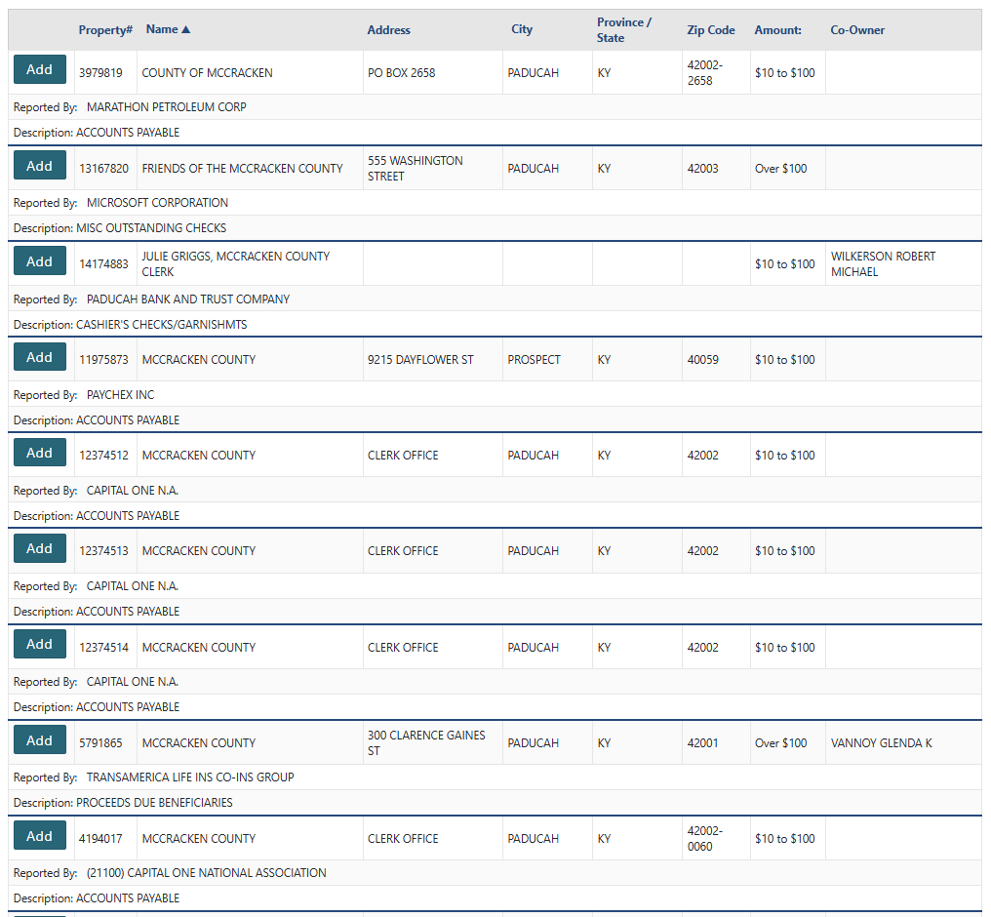
Making a claim is as easy as ordering on Amazon. Just add to cart…

Slide 33


During the first two years of the Metcalf administration, Treasury processed how many Unclaimed Property return requests?
96,779
During the first two years of the Metcalf administration, Treasury returned how much money in Unclaimed Property to Kentucky residents and taxpayers?
$82,000,000.00+

Slide 34
Questions?

Slide 35


Thank you for your attention.

